Slide 1


Making Alexa Skills for Amazon Echo!

Slide 2




Who’s this guy?
Ian Hoppes
@IanHoppes
github.com/ianhoppes
i@iginteractive.com

Slide 3
What is Alexa?
The voice service that powers Echo

Slide 4

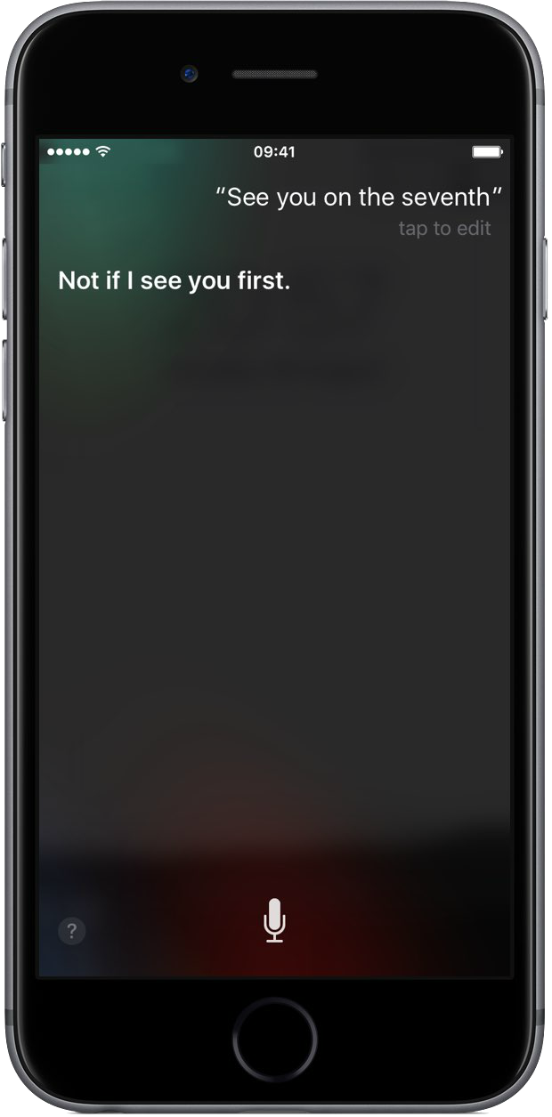


Alexa : Echo :: Siri : iPhone

Slide 5
What is an Echo?
A hands-free speaker you control with your voice

Slide 6

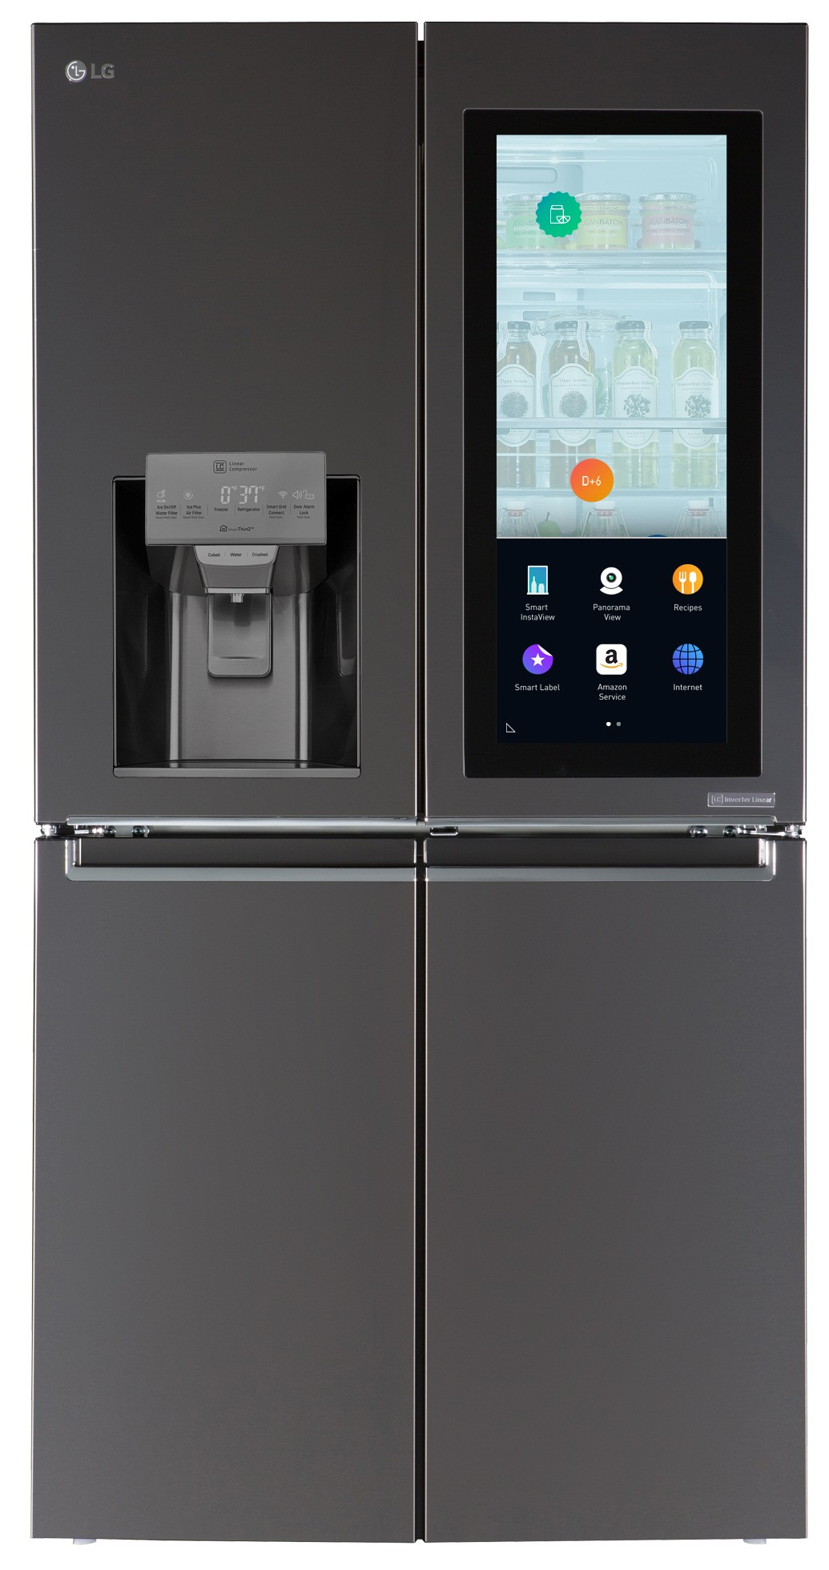
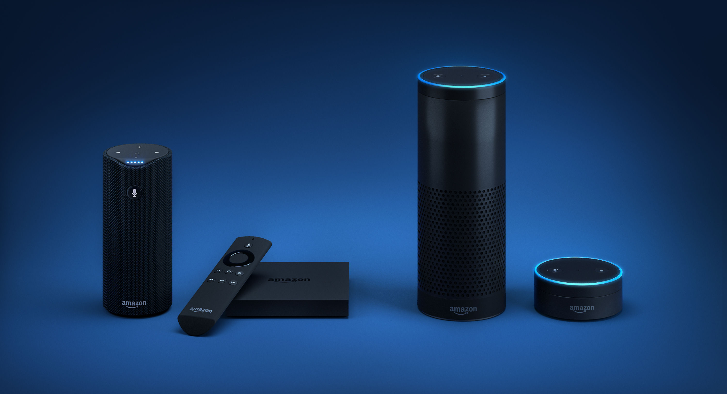
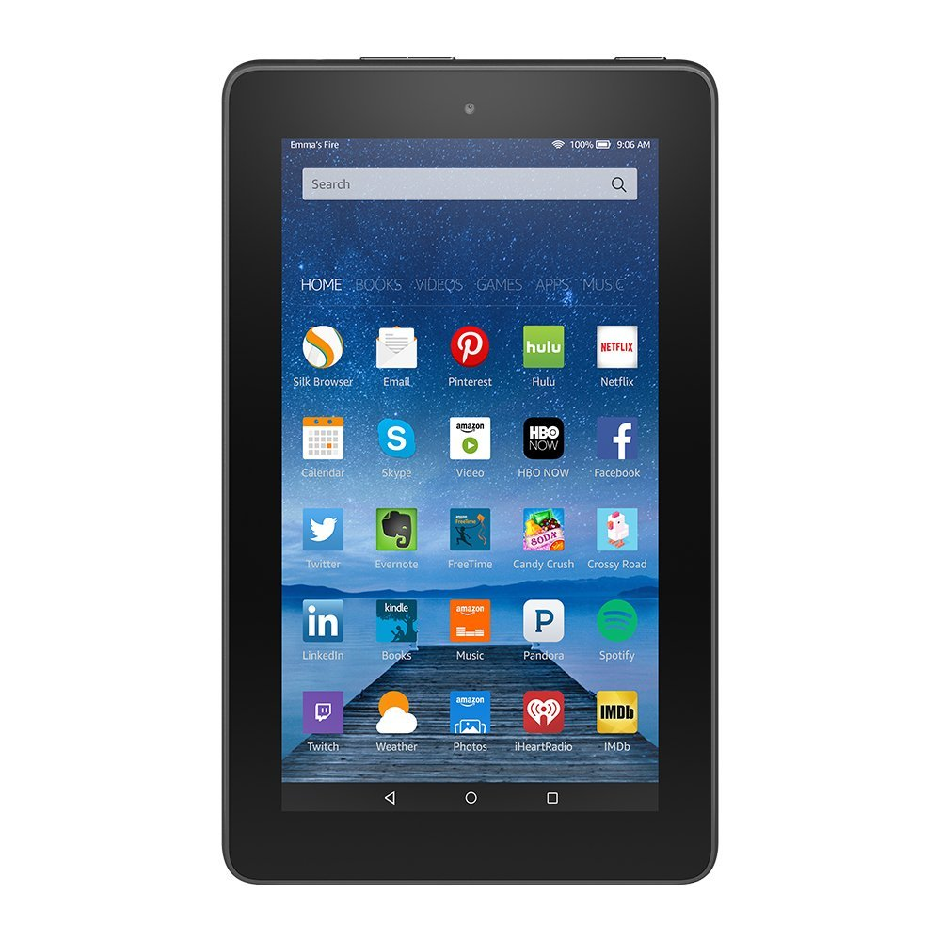




Alexa Devices

Slide 7
What is a Skill?
Capabilities that enable customers to interact with devices in a more intuitive way using voice

Slide 8
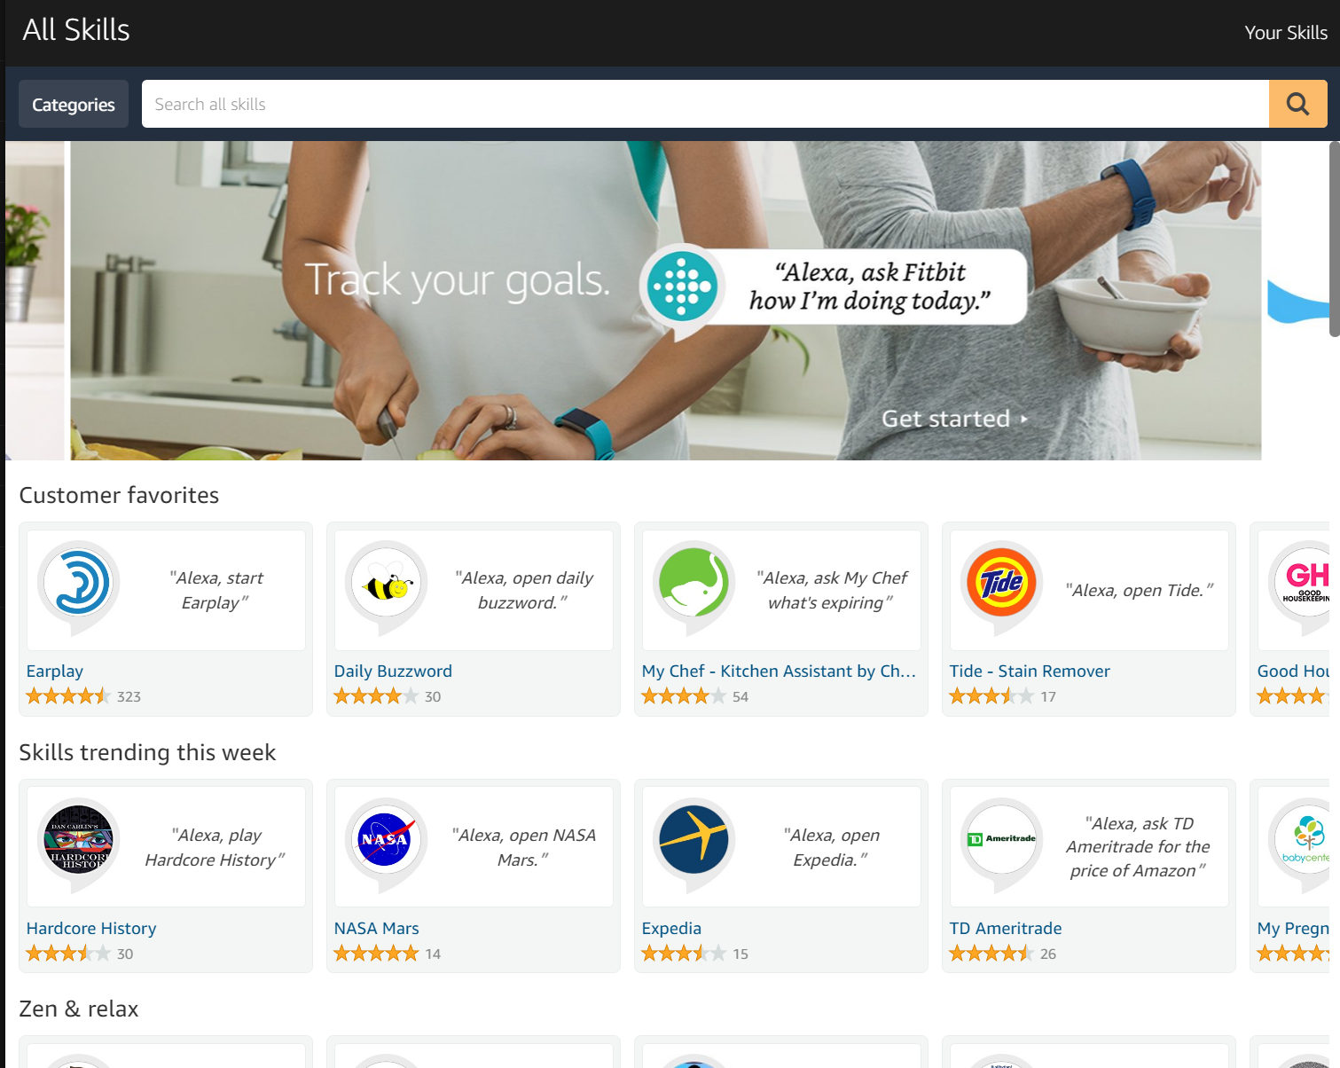
Skill = “App” for Alexa
Over 7,000 skills!
Skill store
3 Types
Custom Skill
Smart Home Skill
Flash Briefing Skill

Slide 9
Building a Custom Skill
Alexa Skills Kit (ASK)
What you need
Voice User Interface
Interaction Model
Logic
Web Service (AWS Lambda)
Amazon Developer account
https://developer.amazon.com
Amazon Web Services account
https://aws.amazon.com
Skill Templates
https://github.com/alexa

Slide 10


Alexa Skills Kit Architecture
Alexa, ask Space Geek for a fact
Interaction Model
Your Logic
Speech
JSON
SSML/Audio
JSON
AWS Lambda
The Sun is an almost perfect sphere.
Text/Image

Slide 11
Voice User Interface
Invocation Name
Wake Word
Invocation Name
Utterances
Intent Schema
Slot Types
Alexa, open Domino’s and
place my Easy Order
Utterance

Slide 12
Logic
JSON request/responses over HTTPS from Alexa Service
AWS Lamdba
Serverless compute
Node.js, Java, Python, and C# (.NET Core)
Easy integration with ASK and other AWS Services
1,000,000 requests free!

Slide 13
Demo
Alexa, ask Space Geek for a fact
Wake Word
Utterance
Invocation Name
Space Geek Fact Skill

Slide 14
Resources
Echosim
https://echosim.io
Amazon Developer Website and Github
https://developer.amazon.com/public/solutions/alexa
https://github.com/alexa
Rob McCauley Cookbook
https://github.com/robm26/Cookbook
Hackster IoT Meetup
https://www.meetup.com/Hackster-Raleigh/

Slide 15
Questions?
Thank you for attending and to Tech Talent South for organizing

